Slide 1

Automatic Attendance Marker
Department of computer Science

Slide 2
Agenda
Introduction
Objective
Methodology
Overview
Project Highlights
Summary

Slide 3
Introduction
Attendance maintenance is a significant function in all the institutions to monitor the performance of the students.
Some of these institutes use the old paper or file-based systems and some have adopted strategies of automatic attendance using some biometric techniques.
A facial recognition system is a computerized biometric software which is suited for determining or validating a person by performing comparison on patterns based on their facial appearances.
Face recognition for the intent of marking attendance is a resourceful application of attendance system.
It is widely used in security systems, and it can be compared with other biometrics such as fingerprint or eye iris recognition systems.

Slide 4
Objective
The main objective to create this application and model which reduce the time consumption and difficulty in maintaining records .
This model can be reliable system to mark attendance without any proxy.
So, this face recognition model helps to mark attendance more accurately and effectively which reduces the time consumption and the hectic maintenance of daily records of attendance

Slide 5
Methodology
Automatic Attendance Marker is a model and web or android Application that helps in marking attendance. It takes less time than the traditional attendance marking system.
IMAGE PROCESSING
FEATURE EXTRACTION
FACE RECOGNITION
IMAGE CLUSTERING
SOFTWARE DESCRIPTION
OpenCV
Pandas
Pandas
Microsoft Excel

Slide 6
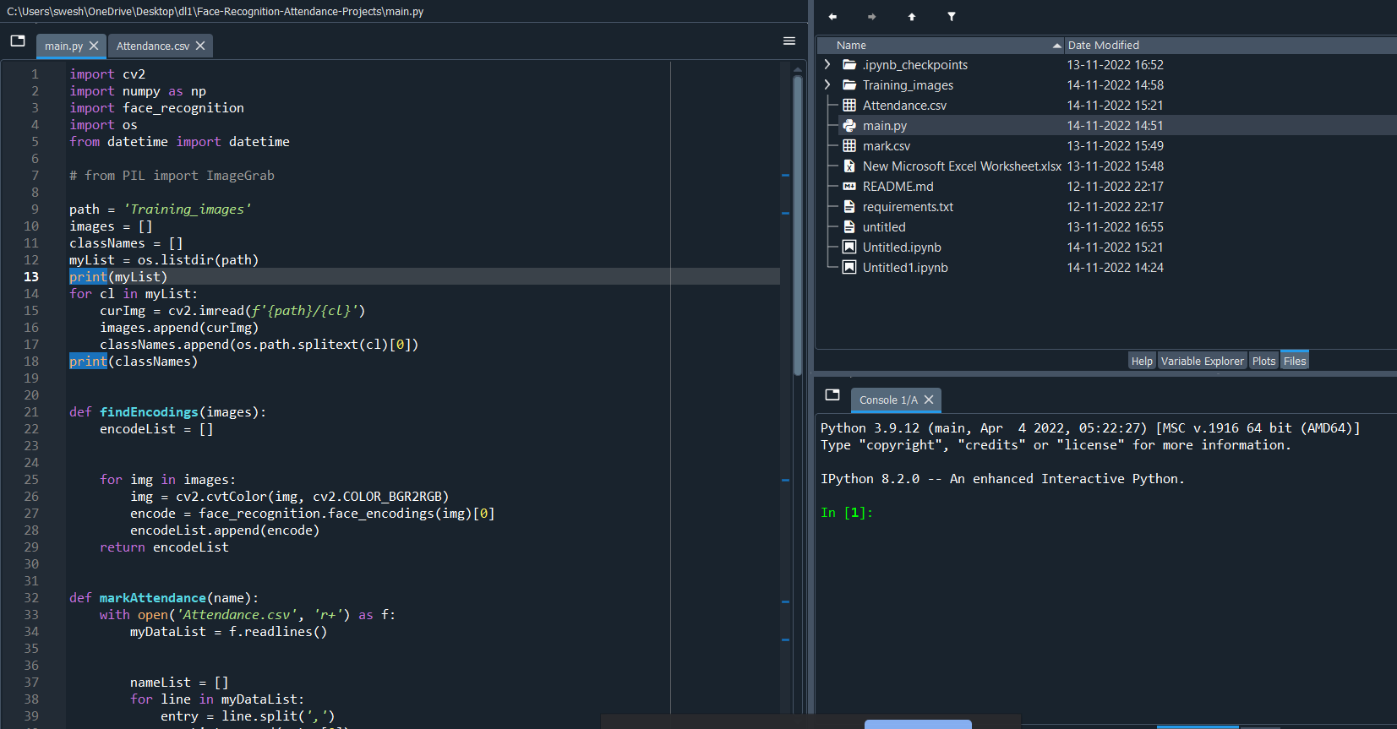
OVERVIEW
In this project Model the attendance of the class students will be marked automatically , by using live video in which multiple faces will be detected at the same time and will be recognized by the prestored dataset and finally the attendance will be marked .
PROJECT HIGHLIGHTS

Slide 7
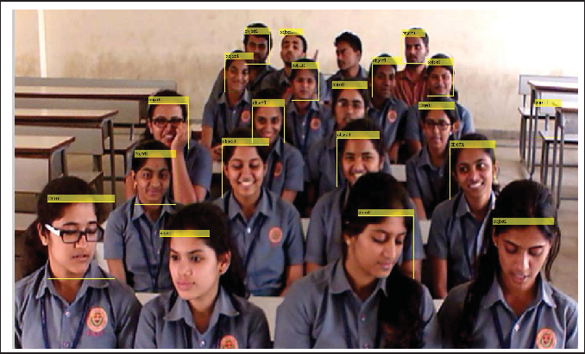
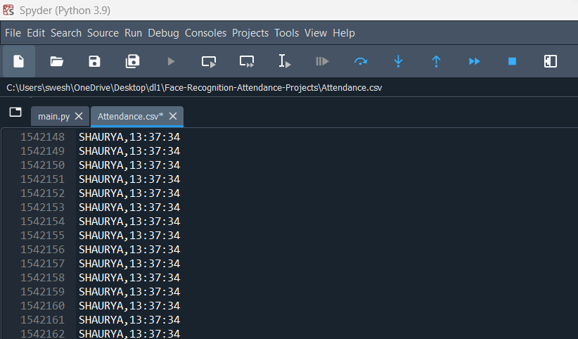
PROJECT HIGHLIGHTS
Webcam Opens
Attendance record in database

Slide 8
Summary
The main goal and objective of this automated attendance system of face detection and recognition is to present face recognition in real time environment for educational institutes or an organization to see and mark the attendance of their students and employees on a daily basis to keep track of their presence. The system will mark and record the attendance in any environment. This system is purely automated and user can capture video and accordingly attendance will be marked, improving the accuracy to great extent and finally the attendance report will be generated.

Slide 9
Thank you
Presented by-
Shaurya Awasthi
(2000290120142) CS-5C
Sparsh Verma
(2000290120164) CS-5C
Tushar Sharma
(2000290120177) CS-5C

